Slide 1
Murder Victim
Q5Age group wise murder victim ?
Query:-
SELECT Area_Name,sum(Victims_Upto_10_Yrs) as Age_Upto_10_Yrs,
sum(Victims_Upto_10_15_Yrs) as Age_10_15_Yrs ,
sum(Victims_Upto_15_18_Yrs) as Age_15_18_Yrs,
sum(Victims_Upto_18_30_Yrs) as Age_18_30_Yrs ,
sum(Victims_Upto_30_50_Yrs) as Age_30_50_Yrs,
sum(Victims_Above_50_Yrs) as Age_Above_50_Yrs ,
sum(Victims_Total)
from "32_Murder_victim_age_sex"
WHERE Sub_Group_Name like "%total%"
GROUP by Area_Name
ORDER by Victims_Total DESC ;

Slide 2
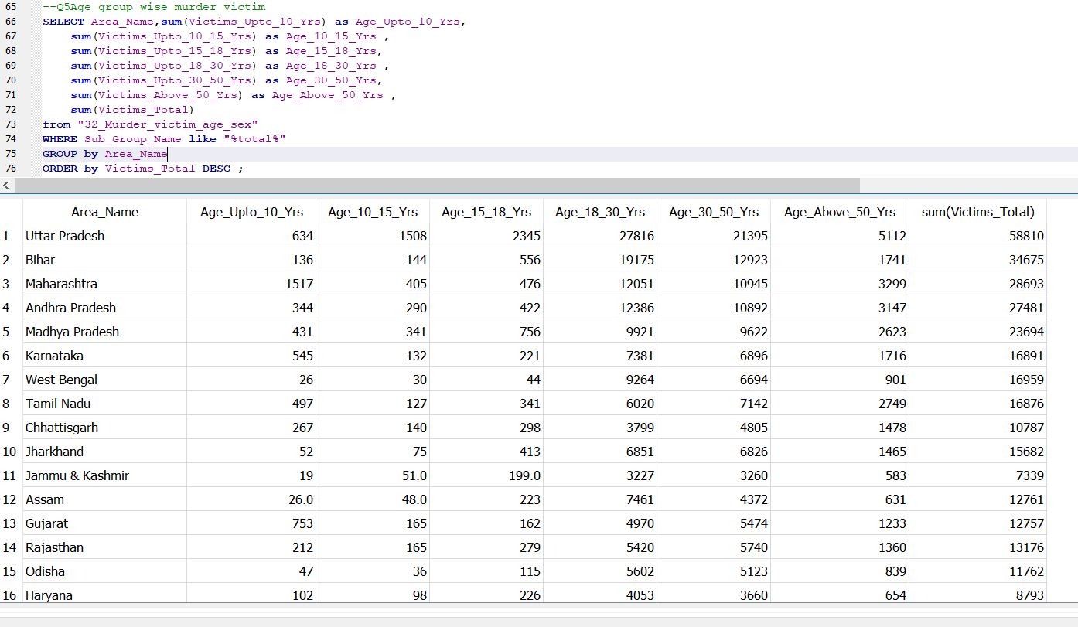
Our query screenshot:-

Slide 3
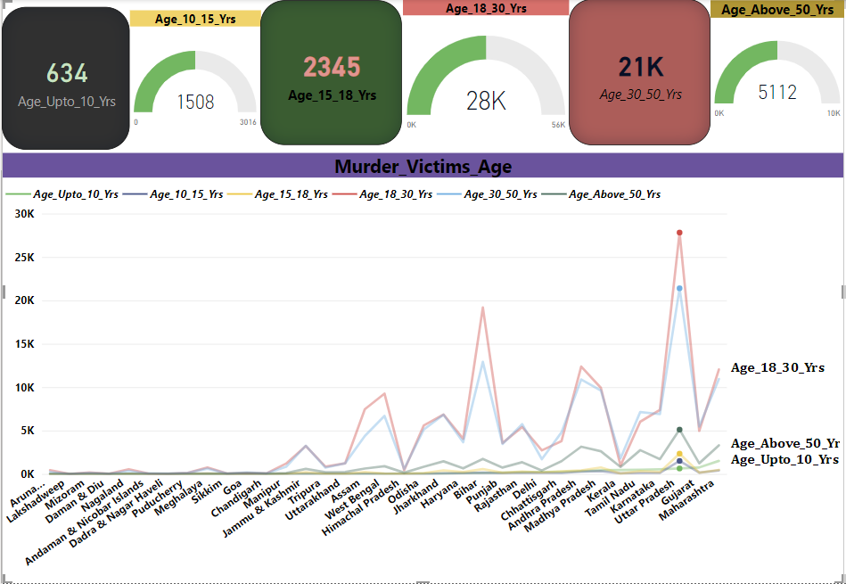
Conclusion:- 1. ﻿Uttar Pradesh had 634 Age_Upto_10_Yrs, 1508 Age_10_15_Yrs, and 2345 Age_15_18_Yrs.

